Slide 1
Embeddings

Slide 2
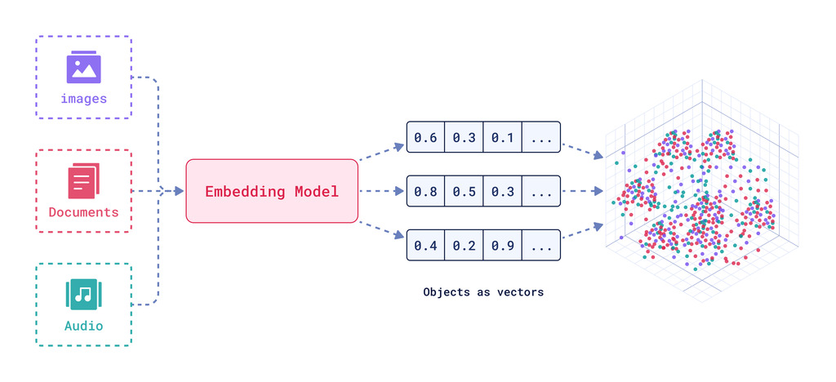
What Are Embeddings?
Embeddings are numerical representations of data that map objects (words, sentences, images, etc.) into continuous vectors in a high-dimensional space.

Slide 3
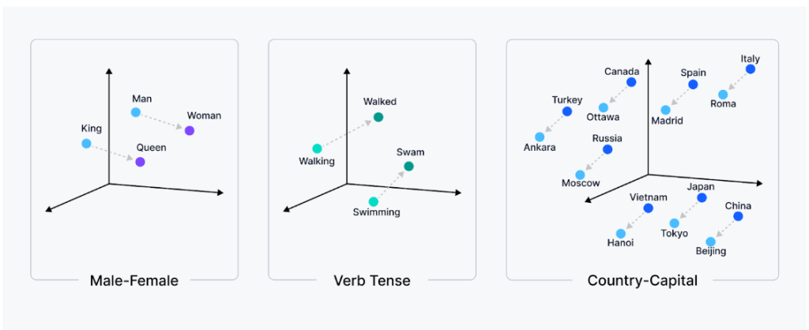
What Are Embeddings?
Embeddings are numerical representations of data that map objects (words, sentences, images, etc.) into continuous vectors in a high-dimensional space.

Slide 4
What Are Embeddings?
They convert complex data (text/images/audio) into numbers that machines can compare.
Similar things → similar vectors (semantic similarity).
Used for search, clustering, recommendations, retrieval systems.
Better than one-hot encoding or raw token IDs because they encode meaning.

Slide 5
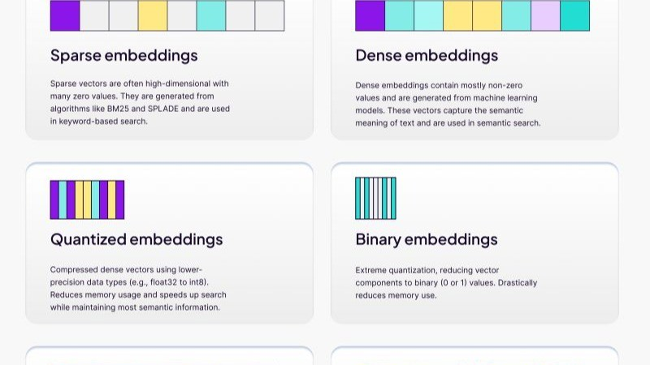
Types of Embeddings

Slide 6
Token vs Sentence vs Document Embeddings
Token embeddings: Represent individual words or subwords.
Good for word-level tasks (e.g., word analogy, translation).
Sentence embeddings: Represent the meaning of complete sentences.
Useful for semantic search, ranking, similarity scoring.
Document embeddings: Represent full documents.
Useful for document retrieval, clustering, summarization.

Slide 7
What Are Embeddings?
Embeddings are numerical representations of data that map objects (words, sentences, images, etc.) into continuous vectors in a high-dimensional space.

Slide 8
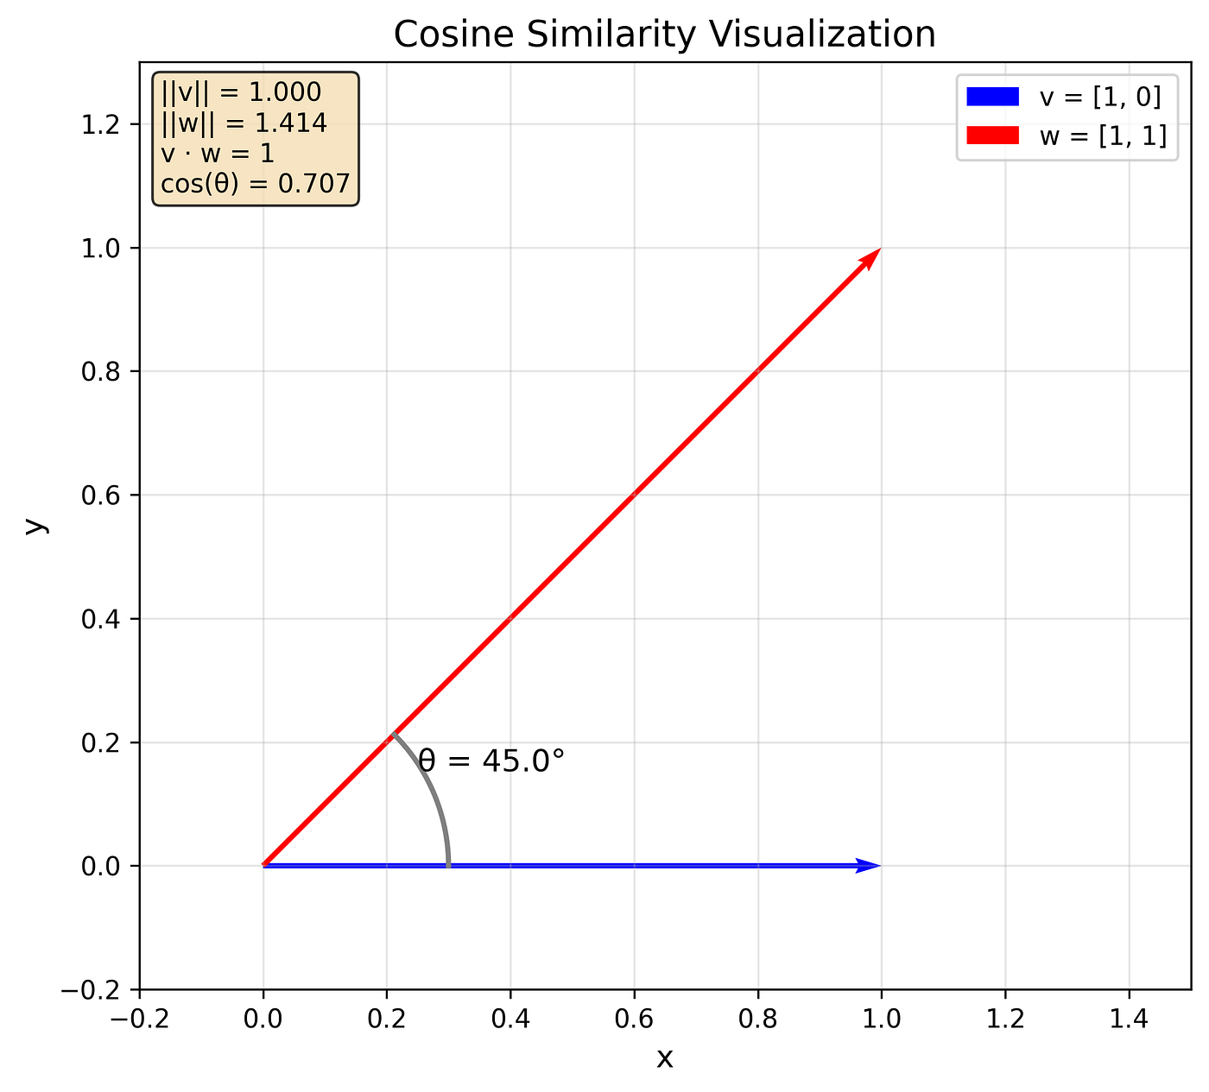
Semantic Similarity
Semantic similarity measures how close in meaning two pieces of text are by comparing their embeddings
Rather than matching keywords, it matches meaning.
Works even if wording is different but meaning is similar.
Enables semantic search, QA, clustering, recommendations.

Slide 9
Vector Space Intuition
When each item is mapped to a vector of numbers, the entire dataset forms a shape in vector space
Vectors are points in a high-dimensional space.
The distance or orientation between these vectors encodes similarity.
Semantic groupings emerge naturally in the space

Slide 10
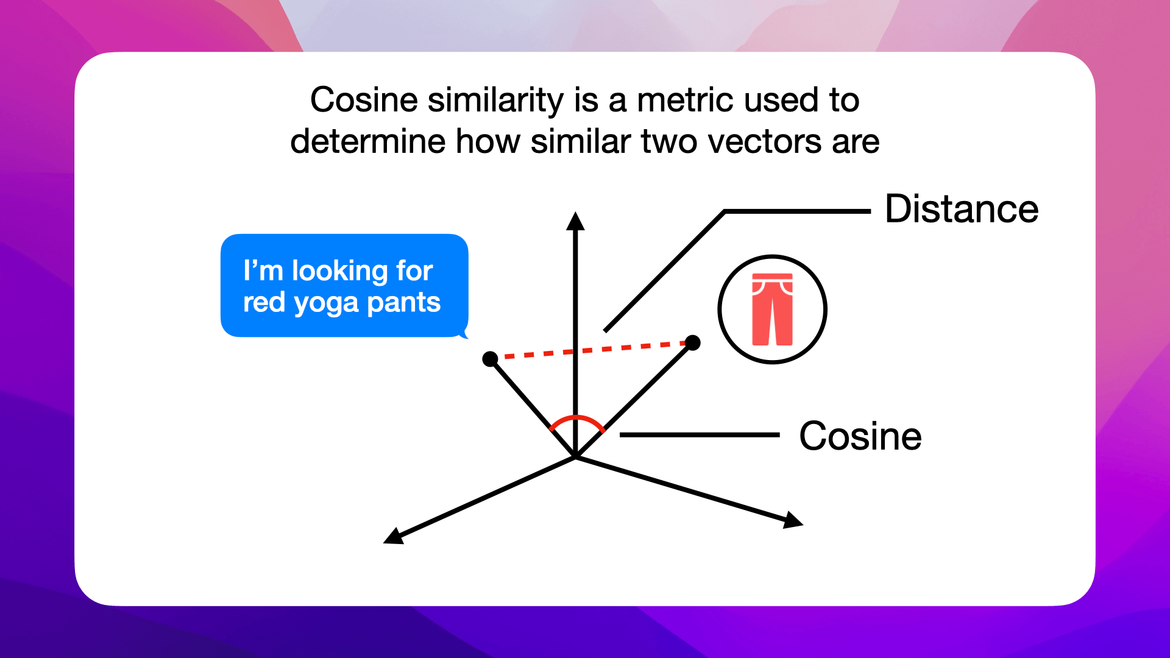
Cosine Similarity & Distance Metrics
Cosine similarity is a widely used metric to measure how similar two vectors are by looking at the angle between them rather than magnitude

Slide 11
Embedding Models and Use Cases
Embeddings are numerical representations of data that map objects (words, sentences, images, etc.) into continuous vectors in a high-dimensional space.
Text embedding models
Word2vec, GloVe → static word embeddings.
BERT, GPT-based encoders → contextual embeddings.
Document / sentence models
Sentence-BERT, Universal Sentence Encoder → sentence representations.
Image / multimodal models
CLIP, multimodal models → align text and image embeddings.

Slide 12
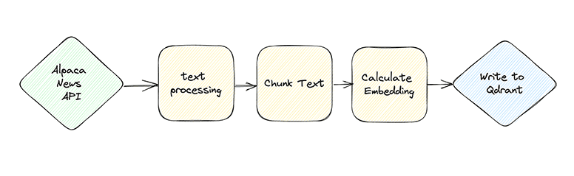
Embedding Pipelines
An embedding pipeline converts raw data into searchable embeddings with steps in between

Slide 13
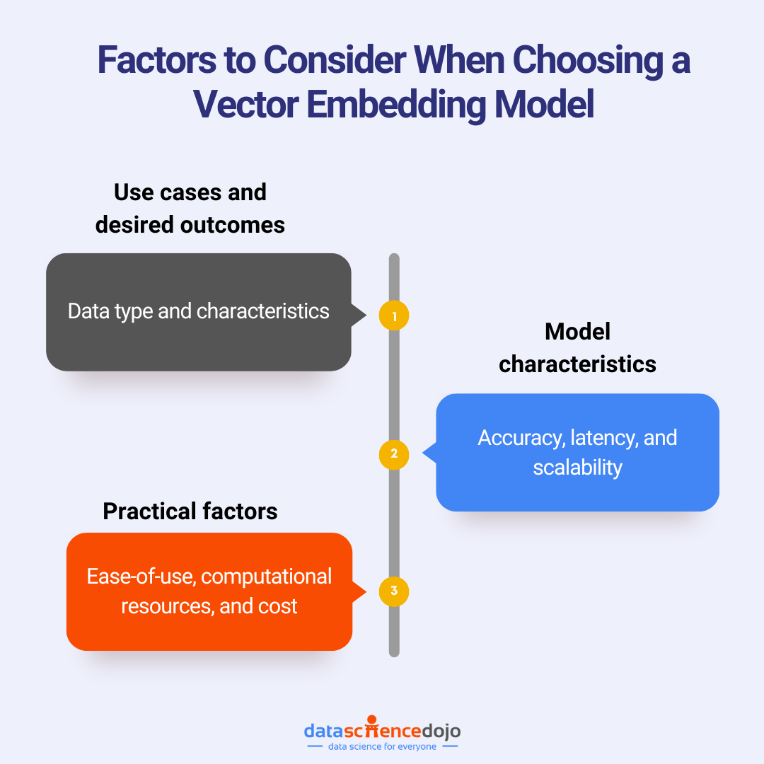
Embedding Quality Considerations
Embedding quality greatly influences retrieval and downstream tasks.
Choose models appropriate for task (sentence vs word).
Ensure enough context in chunks.
Avoid noise (bad text, formatting errors).
Evaluate embeddings on retrieval tasks where possible.
Train or fine-tune on domain data if generic models fail.

Slide 14
Multimodal Embeddings (Overview)
Multimodal embeddings map different data types (text, image, audio, video) into a shared vector space so that semantic relationships can cross modalities
Represent text and images together in the same space.
Useful for cross-modal search (text query → image results).
Enable richer semantic understanding beyond just text.

Slide 15
Multimodal Embeddings (Overview)

